Slide 1
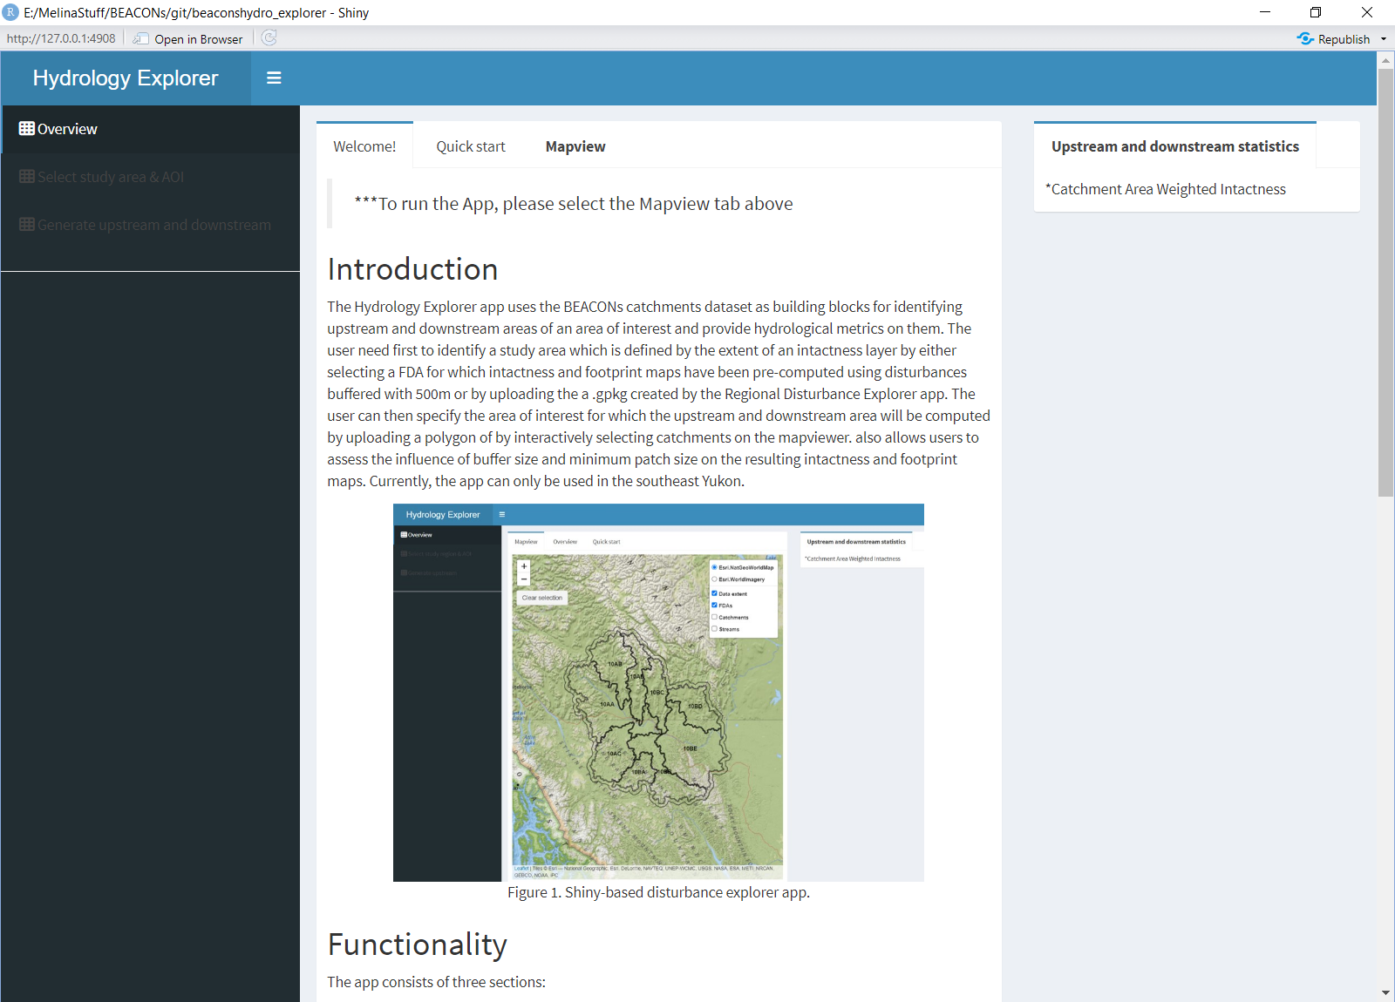

Slide 2
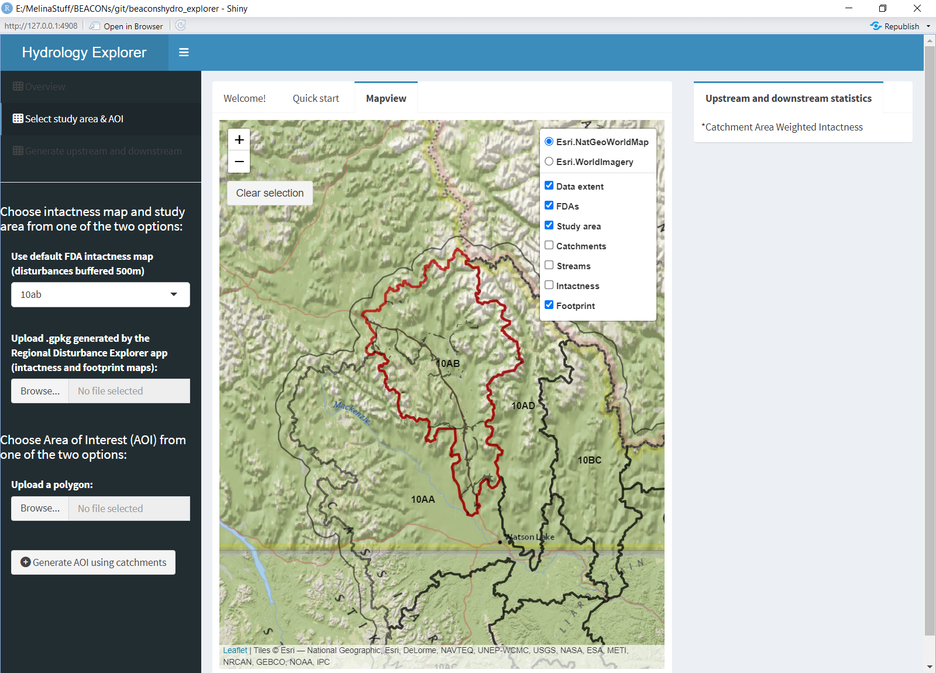
Select your study area
Select a FDA for which intactness and footprint were generated using 500m buffer around linear and areal polygons
Upload your study area by using the .gpkg generated by the Regional Disturbance Explorer app

Slide 3
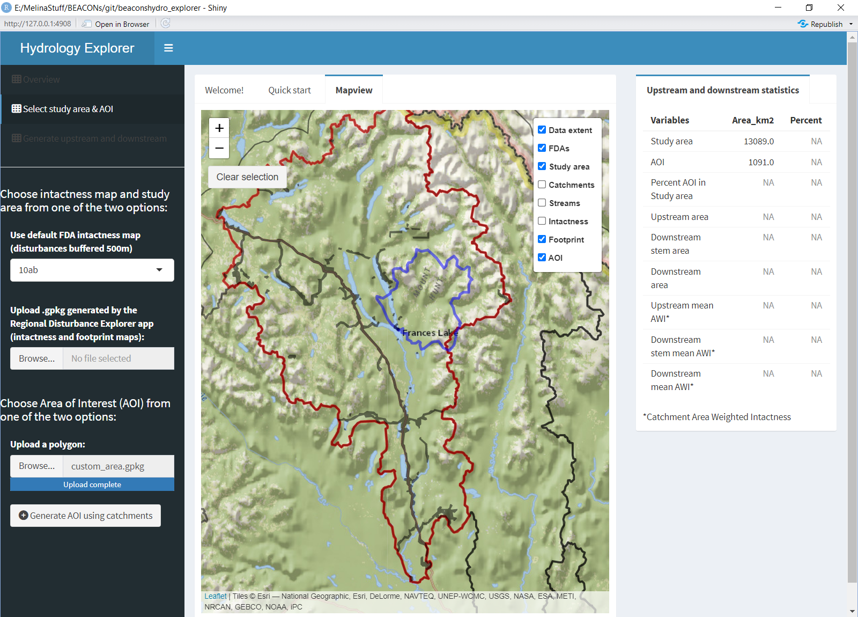
Select your Area of Interest (AOI)
Upload a polygon (.gpkg) that represent your AOI

Slide 4
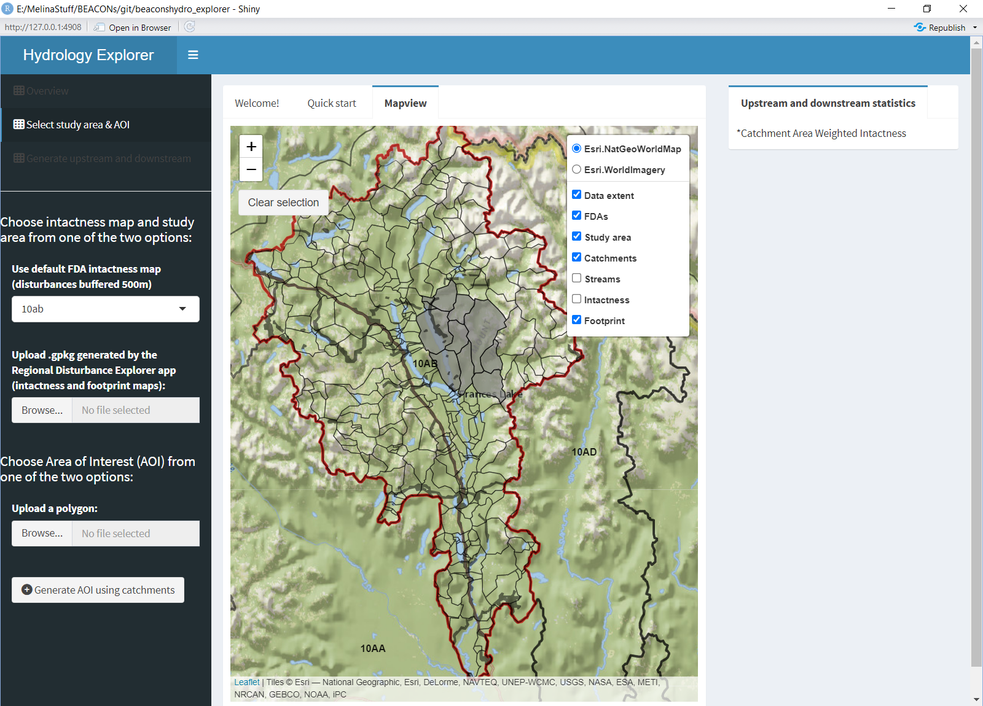
Select your Area of Interest (AOI)
Make sure your catchments layer is turned ON
Generate your AOI by selecting manually the catchments . Make sure the catchment layer is turned ON on the Mapview tab

Slide 5
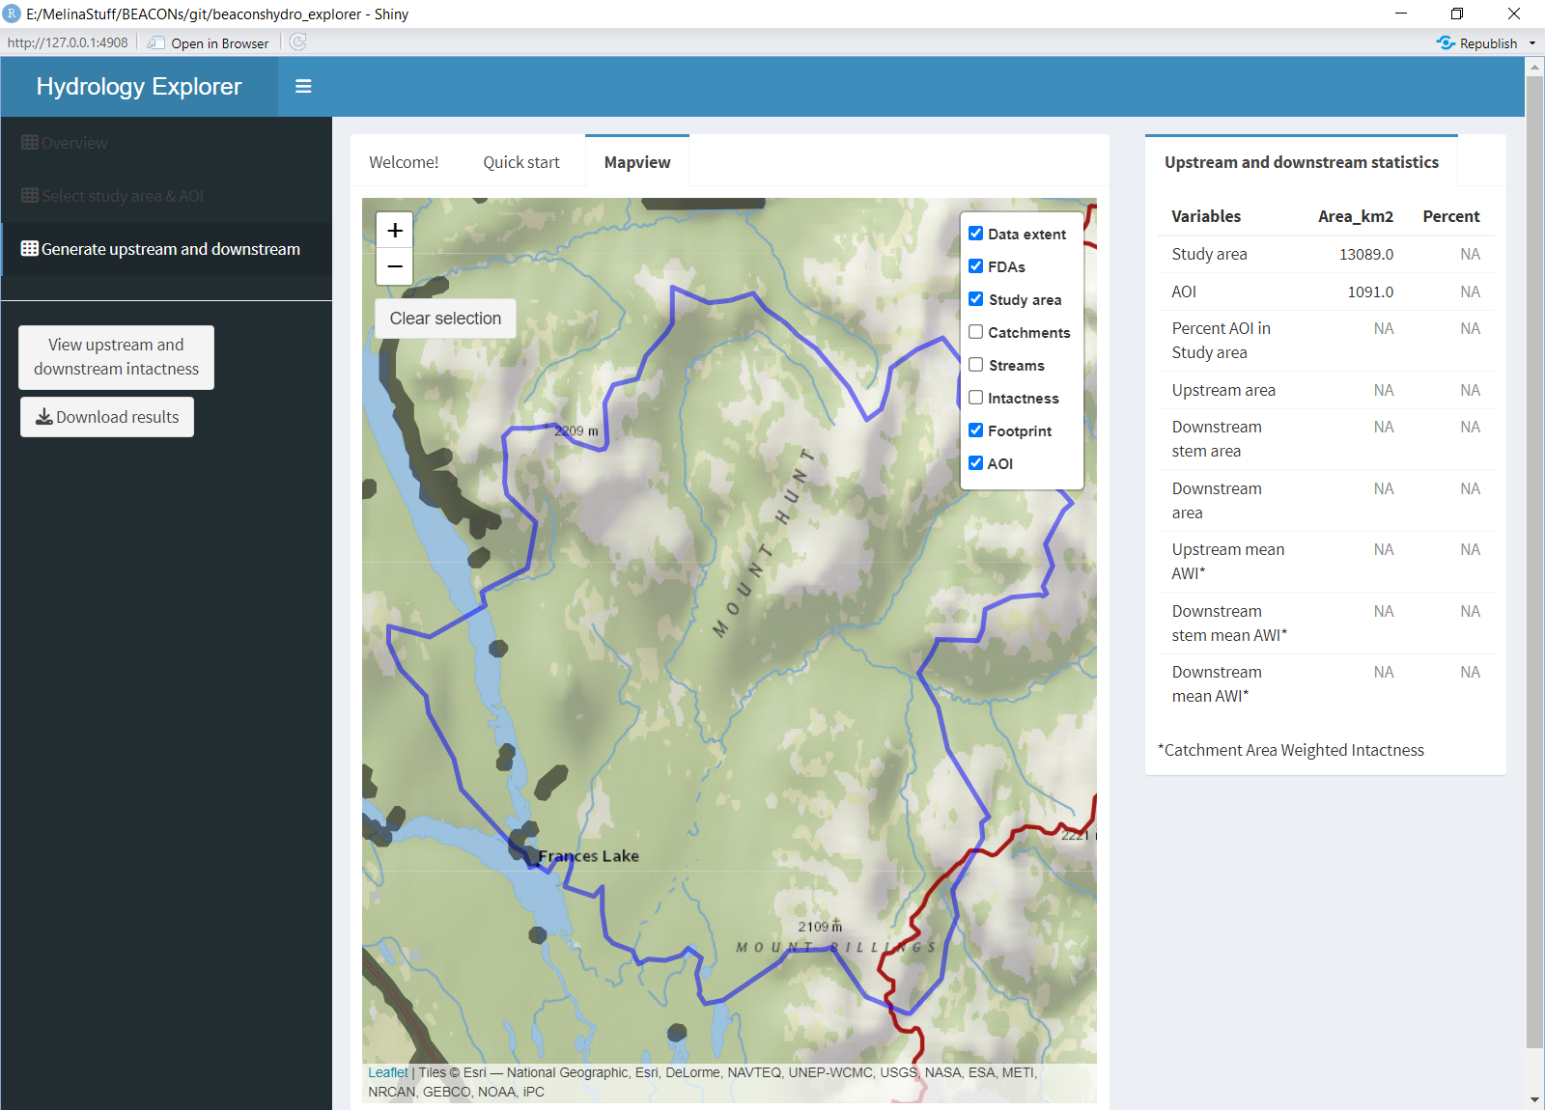
Extract upstream and downstream statistics related to the study region and Area of Interest
Generate the map illustrating upstream and downstream intactnee percent per catchment.

Slide 6
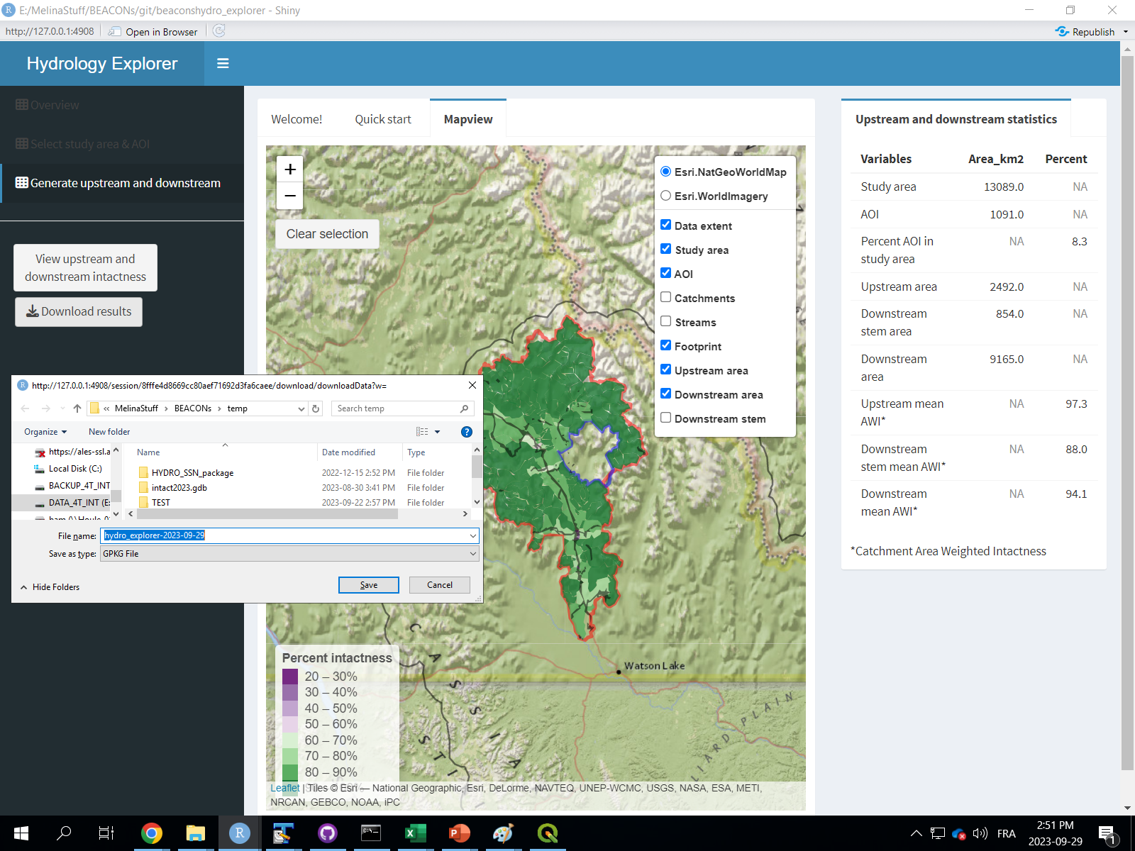
Download a .gpkg representing the catchments overlapping the study region, the identification of the position of the catchmentrelated to the Area of Interest (upstream or downstream) and their respective intactness percent.

